Slide 1

基于导向滤波优化的暗
通道先验去雾算法的硬件实现
成员：刘英杰、潘锐

Slide 2
1
去雾算法的背景及概要
2
基于C++的算法分析与验证
目录
3
硬件实现架构及仿真
CONTENTS
4
Reference

Slide 3
1
去雾算法的背景及概要
PART 01

Slide 4
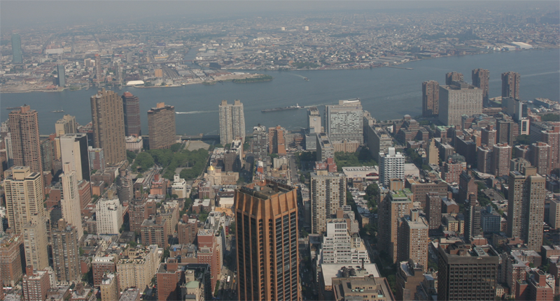
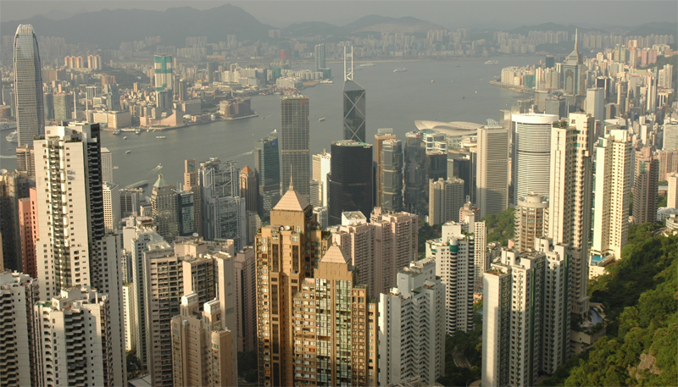
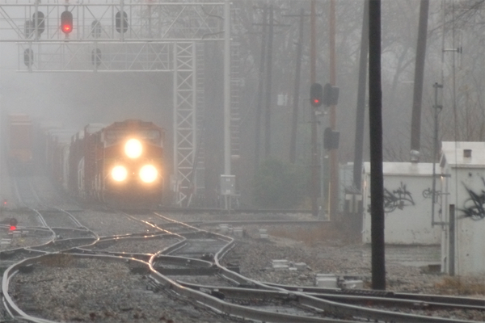
去雾算法的背景及概要
Haze Images
Low visibility
Faint colors

Slide 5
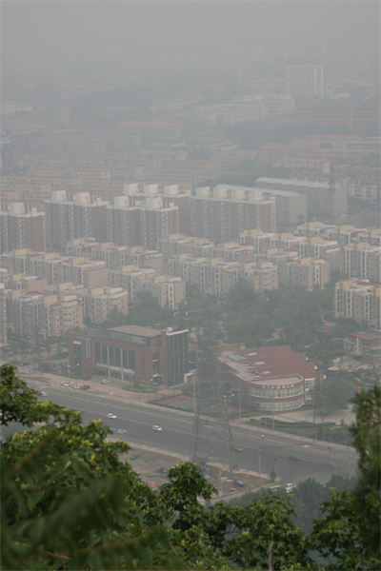
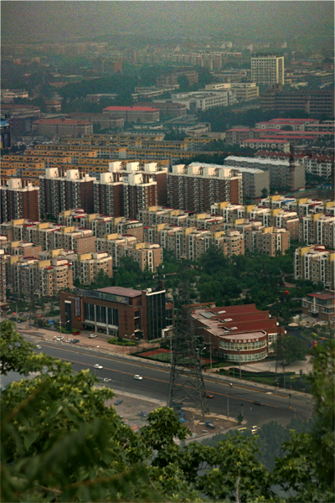
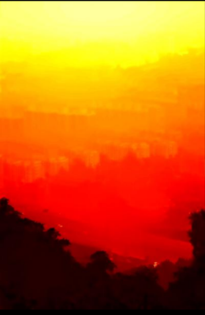
去雾算法的背景及概要
Goals of Haze Removal
Scene restoration
Depth estimation

Slide 6
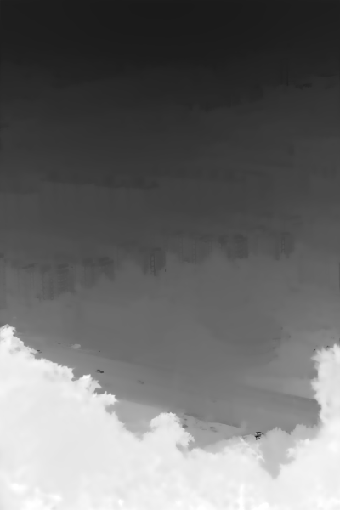
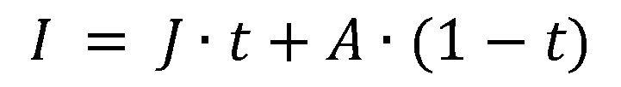
去雾算法的背景及概要
Haze Imaging Model
Atmospheric light
$$I = J∙t+A∙(1−t)$$
Haze image
Scene radiance
Transmission

Slide 7
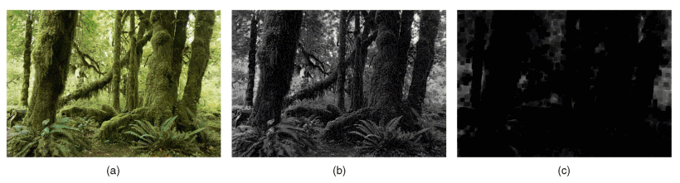
去雾算法的背景及概要
Dark Channel
min(rgb,local patch)
- min(r,g,b)
- min(local patch) = min filter
- J^{c}: color channel of J
- J^{dark}: dark channel of J
dark channel

Slide 8
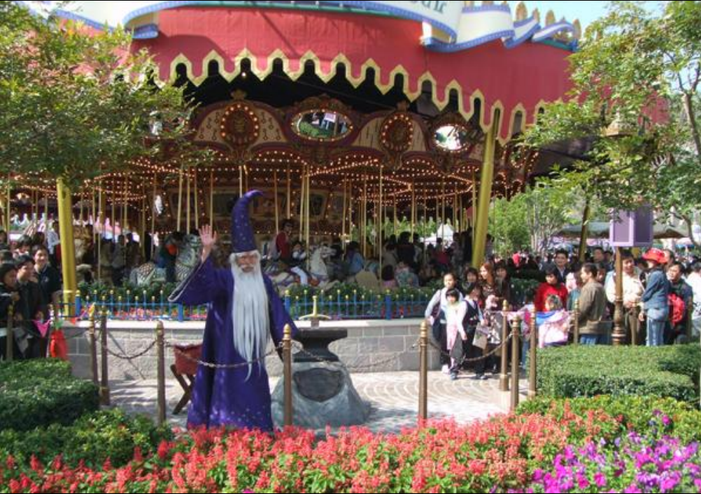
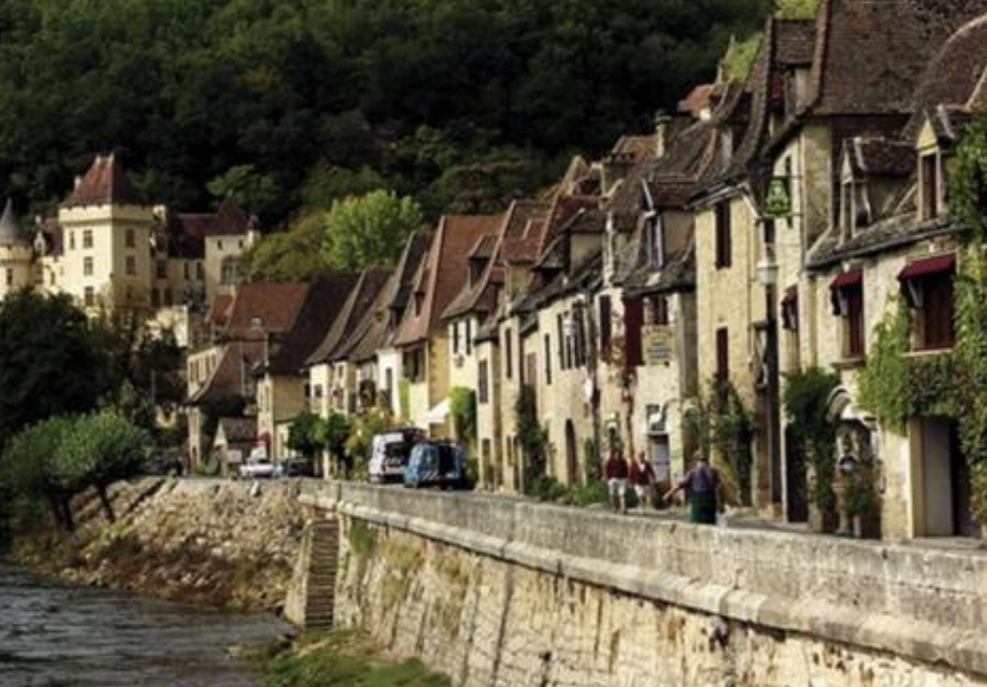
去雾算法的背景及概要
A Superising Observation
Haze-free

Slide 9
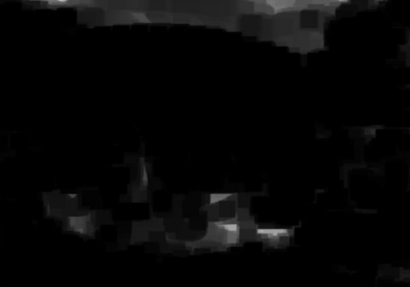
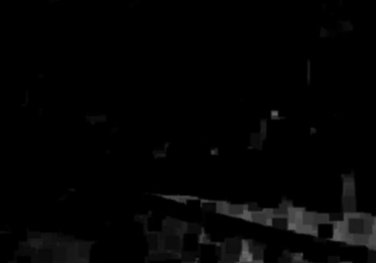
去雾算法的背景及概要
A Superising Observation
Haze-free

Slide 10
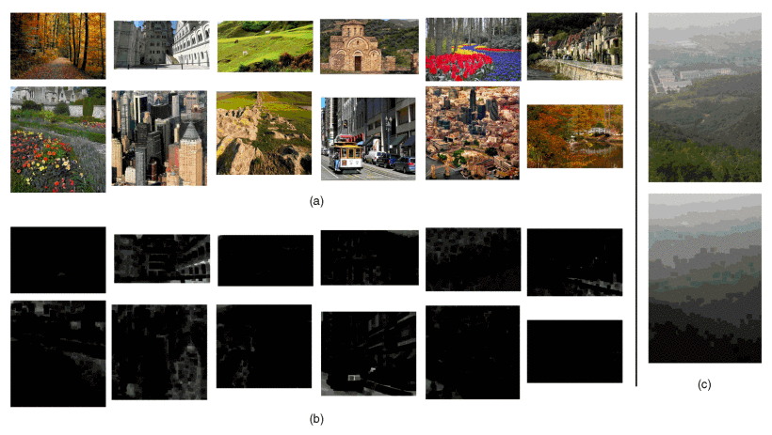
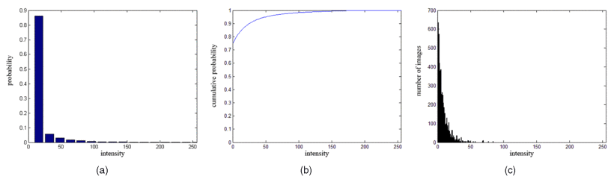
去雾算法的背景及概要
A Superising Observation
86% pixels in [0, 16]
5,000 haze-free images

Slide 11
去雾算法的背景及概要
Dark Channel Prior
For outdoor haze-free images

Slide 12
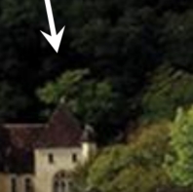
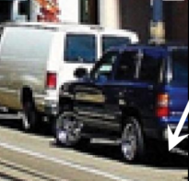
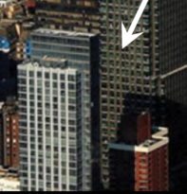
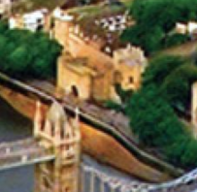
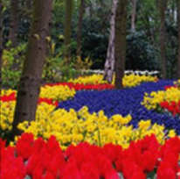
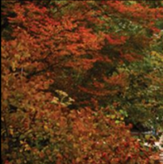
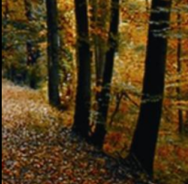
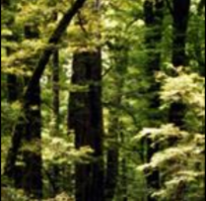
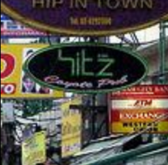
去雾算法的背景及概要
What makes it dark?
Shadow
Colorful object
Black object

Slide 13

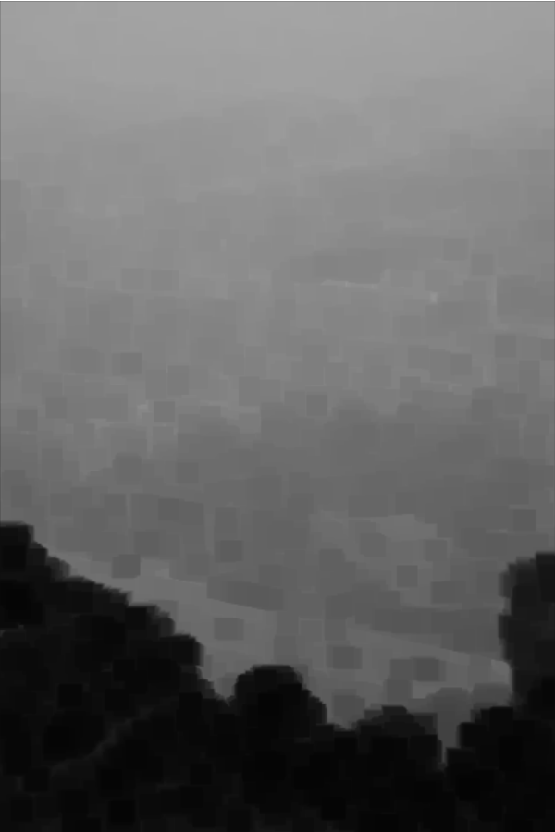
去雾算法的背景及概要
Dark Channel of Hazy Image
haze image
dark channel
The dark channel is no longer dark.

Slide 14
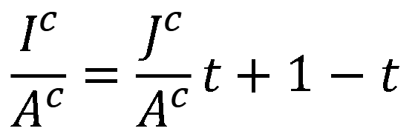
去雾算法的背景及概要
Dark Channel of Hazy Image
Haze imageing model
$$I = J∙t+A∙(1−t)$$
$$\frac{I^{c}}{A^{c}}=\frac{J^{c}}{A^{c}}t+1−t$$
Normalize
Compute dark channel

Slide 15
去雾算法的背景及概要
Transmission Estimation
Dark Channel Prior
Compute dark channel
0

Slide 16
去雾算法的背景及概要
Transmission Estimation
Estimate transmission
Compute dark channel

Slide 17
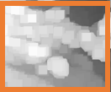
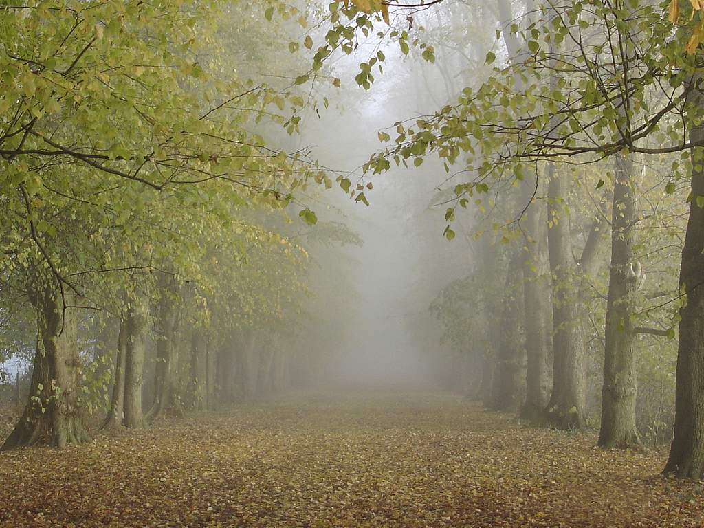
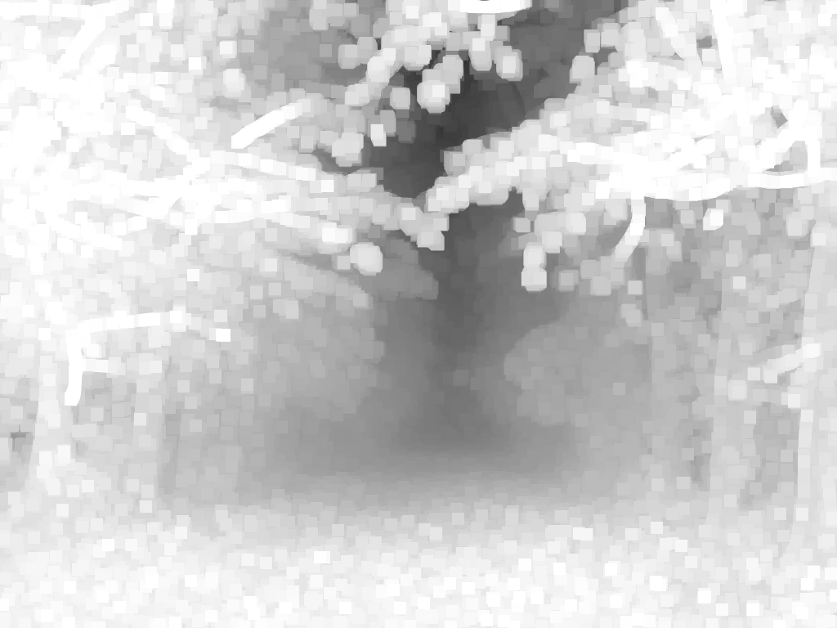
去雾算法的背景及概要
Transmission Estimation
Estimate transmission
input I
estimated t

Slide 18
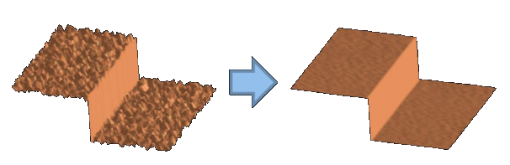
去雾算法的背景及概要
Transmission Optimization
Introduction
Edge-preserving filtering
- An important topic in computer vision
Denoising, image amoothing/sharpening, texture decomposition, HDR compression, image abstration, optical flow estimation, image superresolution, feature smoothing...

Slide 19
去雾算法的背景及概要
Transmission Optimization
Introduction
Our target - to design a filter
- Edge-preserving filtering
- Non-iterative
- O(1) time, fast and non-approximate
- No gradient distortion

Slide 20
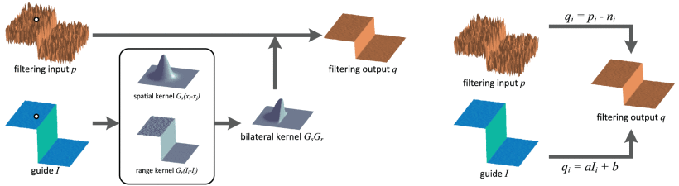
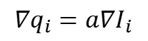
去雾算法的背景及概要
Transmission Optimization
Guided filter
noise / texture
Linear regression
$$∇q_{i}=a∇I_{i}$$

Slide 21
去雾算法的背景及概要
Transmission Optimization
before optimization

Slide 22
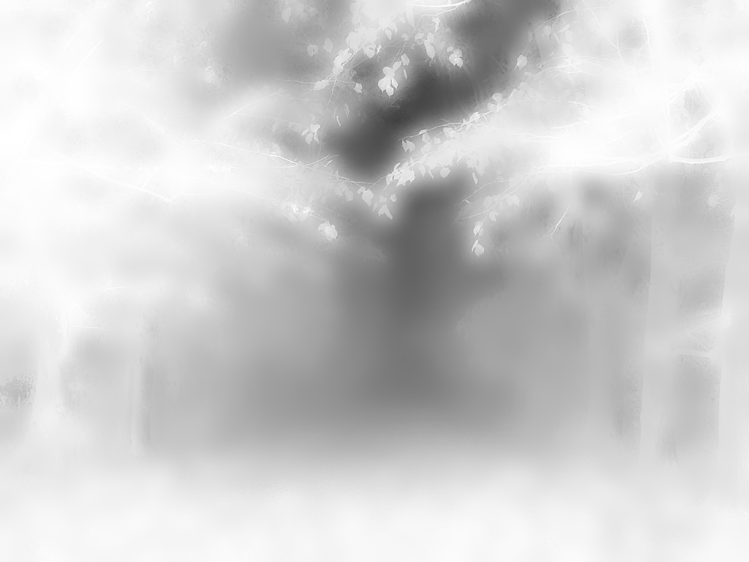
去雾算法的背景及概要
Transmission Optimization
after optimization

Slide 23
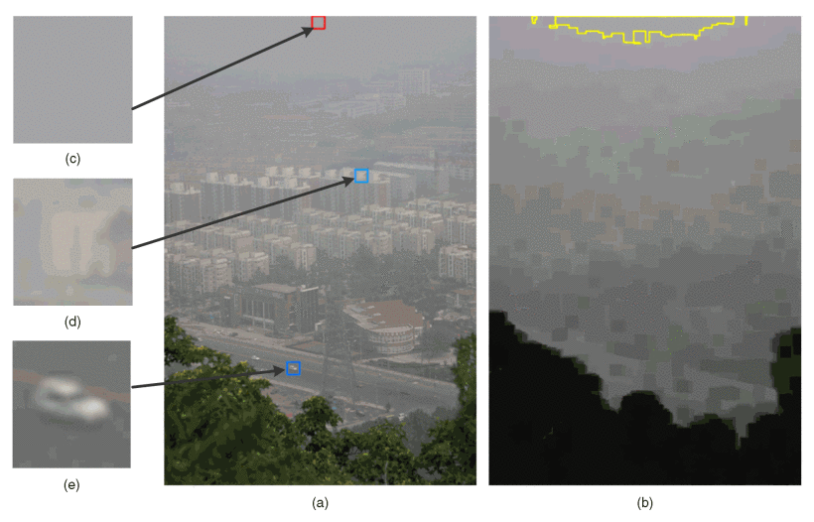
去雾算法的背景及概要
Atmospheric Light Estimation
brightest pixels
most hazy
pixels brighter than the atmospheric light
haze image
dark channel

Slide 24
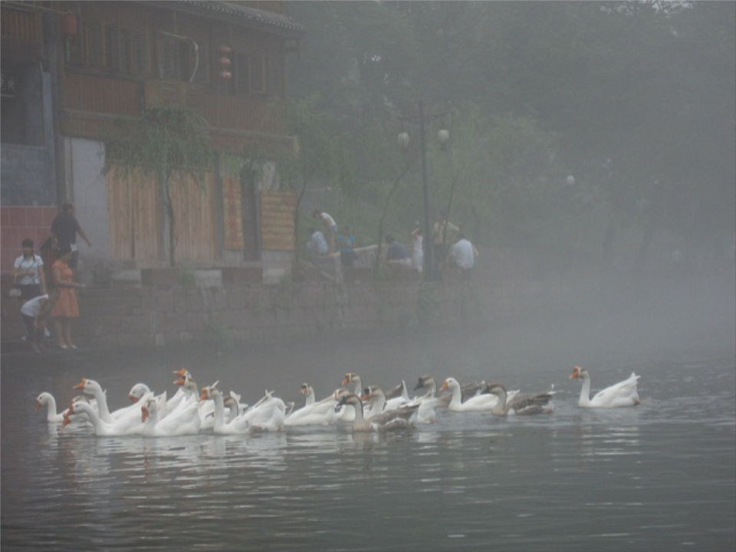
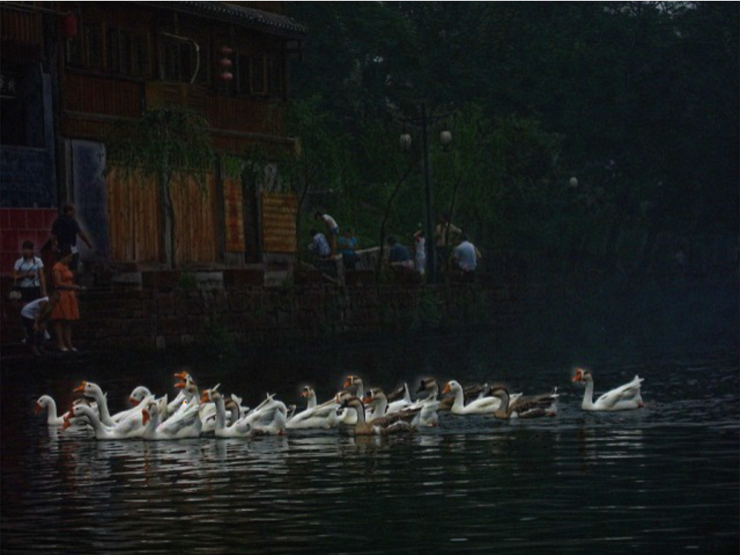
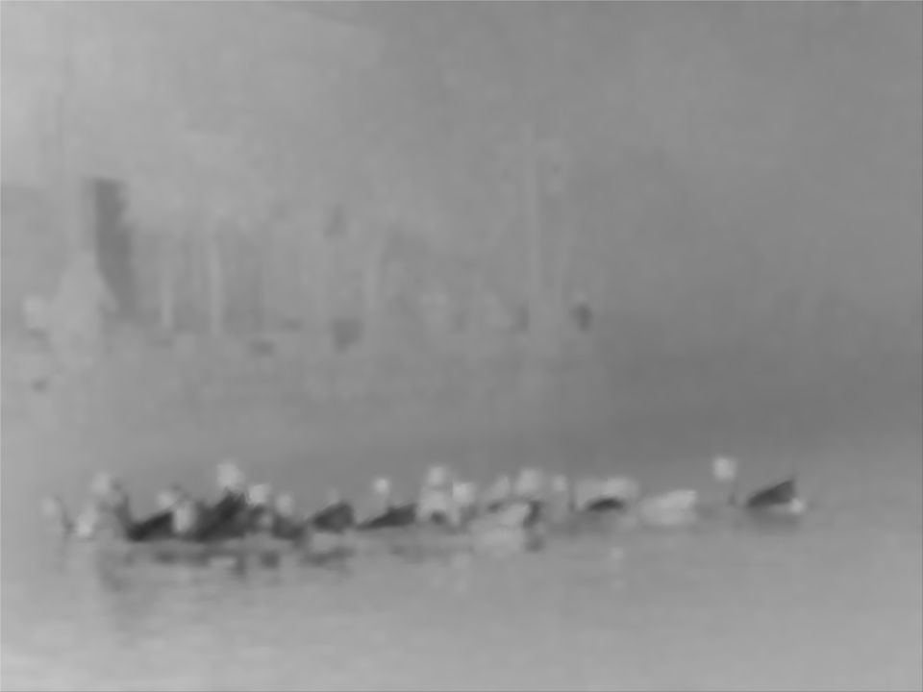
去雾算法的背景及概要
Scene Radiance Restoration
Atmospheric light
$$I = J∙t+A∙(1−t)$$
haze image
scene radiance
transmisson

Slide 25
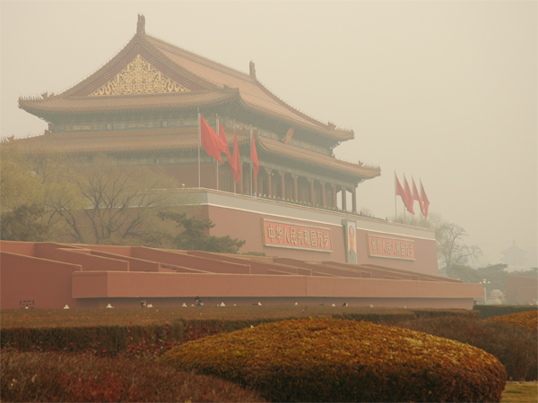
去雾算法的背景及概要
Result
input

Slide 26
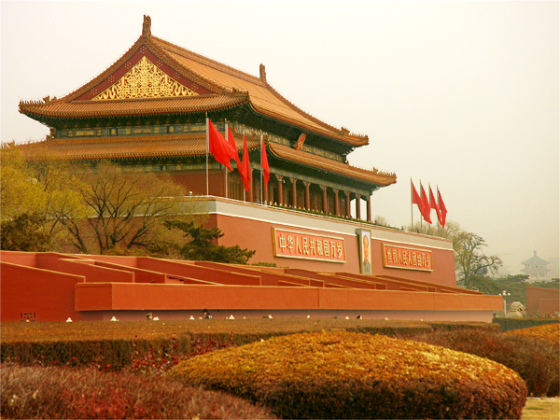
去雾算法的背景及概要
Result
recovered image

Slide 27
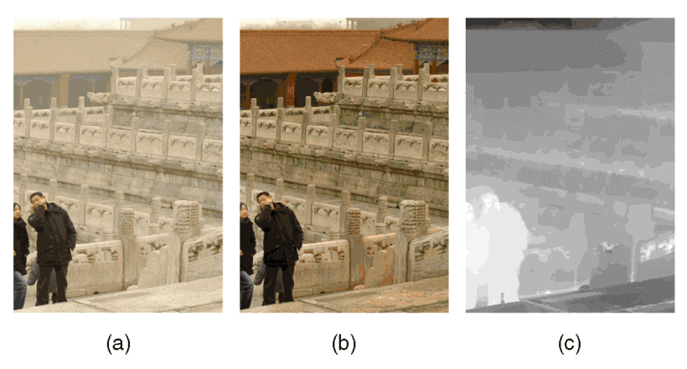
去雾算法的背景及概要
Limitation
Inherently white or grayish objects
Notes:
Since the dark channel prior is a kind of statistics, it may
not work for some particular images. When the scene
objects are inherently similar to the atmospheric light and
no shadow is cast on them (such as the white marble in
Fig. 18), the dark channel prior is invalid. The dark channel
of the scene radiance has bright values near such objects. As
a result, our method will underestimate the transmission of
these objects and overestimate the haze layer.

Slide 28
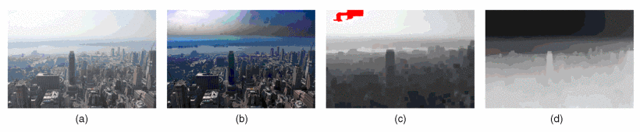
去雾算法的背景及概要
Limitation
Haze imaging model is invalid
Notes:
when the sunlight is very influential. In Fig. 19a, the
atmospheric light is bright on the left and dim on the right.
Our automatically estimated A (Fig. 19c) is not the real A in
the other regions, so the recovered sky region on the right is
darker than it should be (Fig. 19b).

Slide 29
去雾算法的背景及概要
Summary
Dark channel prior
- A natural phenomenon
- Very simple but effective
- Put a bad image to good use

Slide 30
2
基于C++的算法分析和验证
PART 02

Slide 31
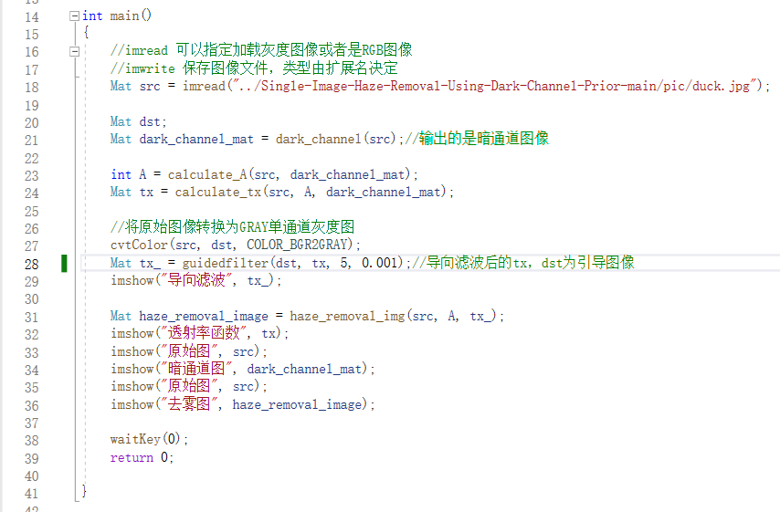
算法验证
在实际FPGA开发的过程中，单仿真需耗费很长的时间，往往需先用高级语言搭建一套完整的实现流程，方便FPGA开发时的验证。
而在图像处理操作中，可以应用C++去方便的调取OPEN_CV库中的一些接口函数，并且有一些便利的类可以使用，因此选用C++来对算法进行程序验证和分析

Slide 32
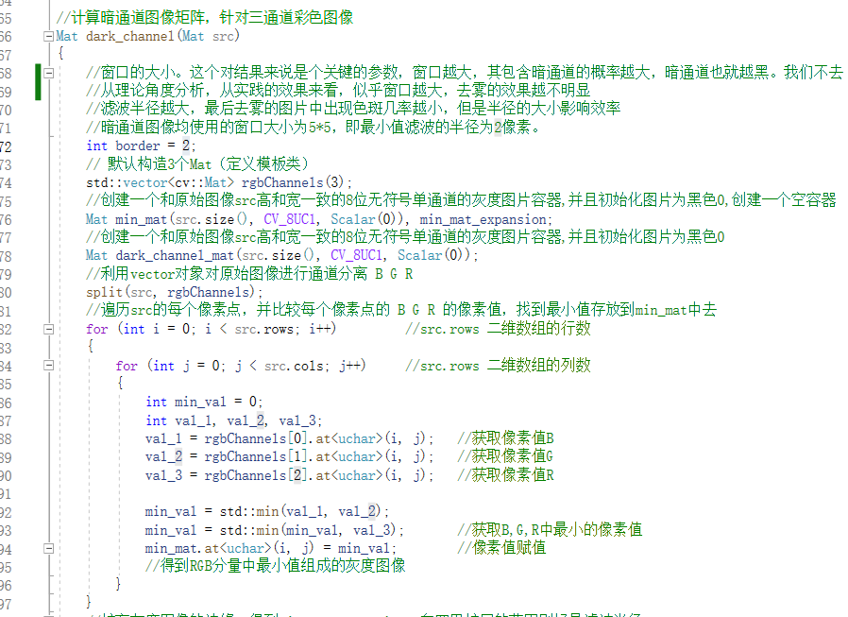
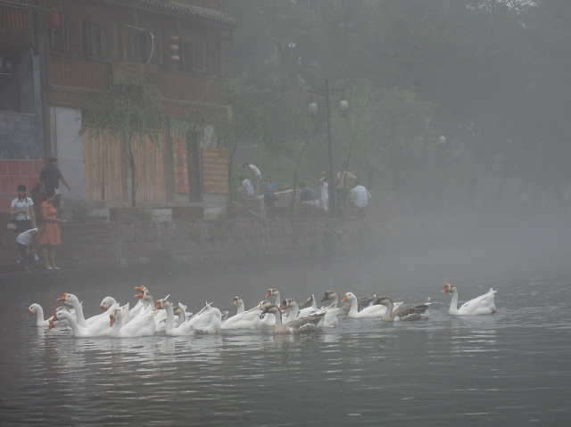
算法验证
获得暗通道图像
遍历原始图像的所有像素点，找到每个像素点三个通道中的最小值，将最小值组成单通道图。

Slide 33
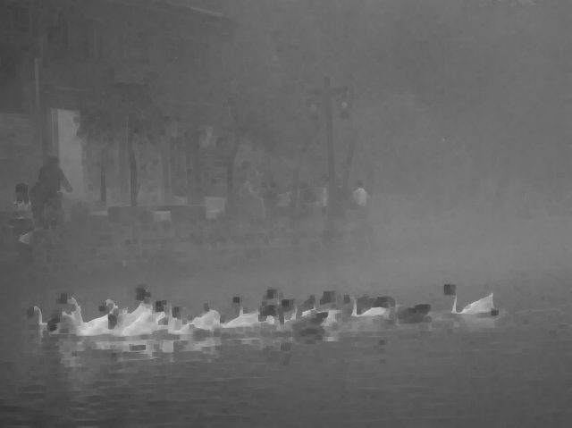
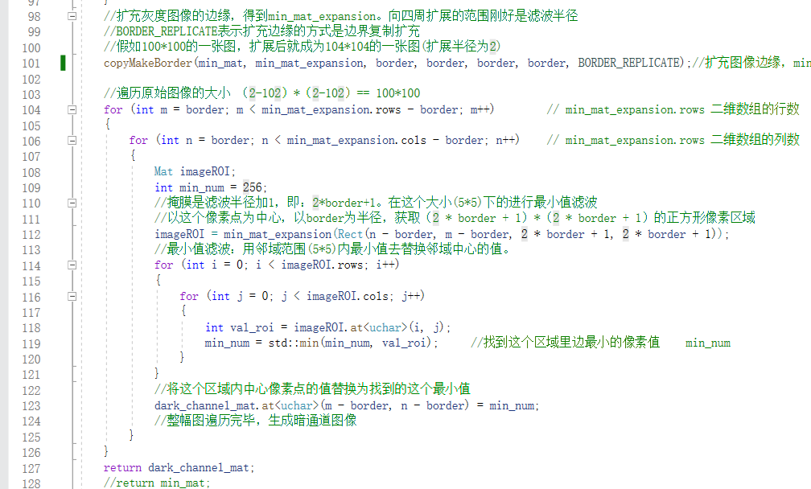
算法验证
获得暗通道图像
将获得的单通道图进行扩展，扩展范围等于滤波半径。对扩展前图像的每一个像素点进行滤波半径为r的均值滤波，最后得到暗通道图

Slide 34
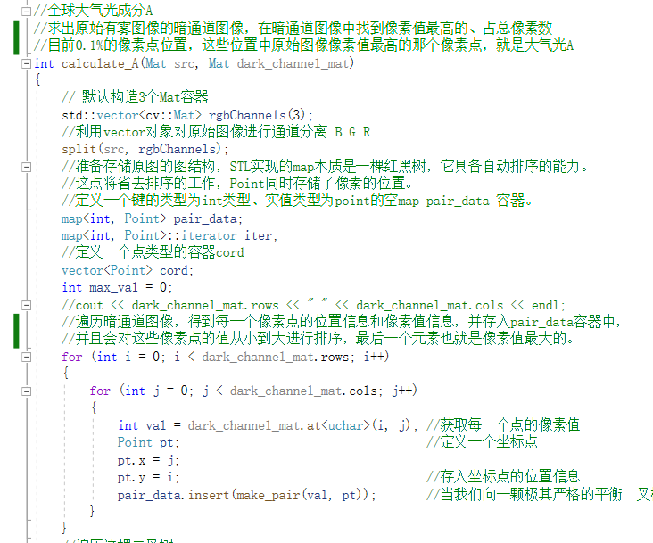
算法验证
计算全球大气光成分A
遍历暗通道图每一个像素点的像素值，存储的过程并完成从大到小排序，同时包含每个像素点的位置信息。

Slide 35
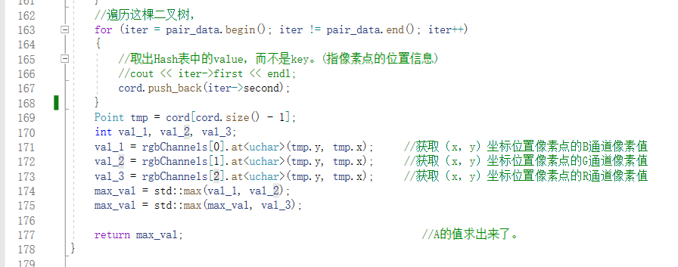
算法验证
计算全球大气光成分A
找出存储的像素点值最大的像素点的位置信息，与之对应找到原图像该位置的像素点。比较三个通道的像素值，即可得到A的值。

Slide 36
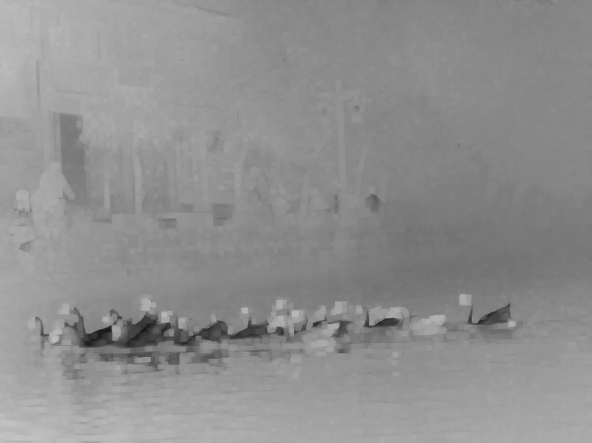
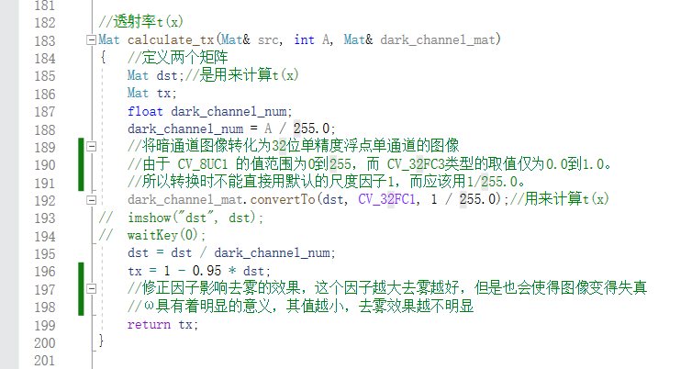
算法验证
计算透射率t
输入暗通道图和A的值，带入对应的计算公式得到透射率图

Slide 37




算法验证
导向滤波优化透射率图t
算法步骤如下：
计算引导图G的积分图和平方积分图
计算输入图像P的积分图， P和G的乘积积分图
用上两步得出的积分图计算P和G的均值，G的方差，P和G的协方差，窗口半径为r
然后用下式计算系数图A和B
计算A和B的积分图
计算A和B的窗口半径r的均值，并用下式计算输出图Q

Slide 38

算法验证
导向滤波优化透射率图t

Slide 39


算法验证
去雾
对原始图像每一个像素点的每一个通道值都程序中的公式处理，最后将三通道合并，得到去雾后的图像。

Slide 40
3
硬件实现架构及仿真分析
PART 03

Slide 41

实现架构及仿真分析
algorithm flow
camera_data_make
dark_channel
calculate_A
tx_get
time_alignment
haze_remove_cal

Slide 42

实现架构及仿真分析
algorithm flow
camera_data_make
camera data stream
Notes:
在FPGA实现上的架构上，用testbench文件读取图片数据并产生行场同步，使能等数据信号模拟摄像头输入，作为本次去雾算法实现的数据输入。

Slide 43


实现架构及仿真分析
algorithm flow
dark_channel
find min value of RGB channel
min value filter

Slide 44


实现架构及仿真分析
algorithm flow
dark_channel
convolution operator

Slide 45

实现架构及仿真分析
algorithm flow
calculate_A
previous frame value

Slide 46

实现架构及仿真分析
algorithm flow
tx_get
transmission value

Slide 47
实现架构及仿真分析
algorithm flow
time_alignment
transmission value

Slide 48

实现架构及仿真分析
algorithm flow
haze_remove_cal
final result

Slide 49


实现架构及仿真分析
Simulation Result
haze image
scene radiance

Slide 50


实现架构及仿真分析
Site test
haze image
scene radiance

Slide 51
4
Reference
PART 04

Slide 52
Reference
K. He, J. Sun and X. Tang, "Single Image Haze Removal Using Dark Channel Prior," in IEEE Transactions on Pattern Analysis and Machine Intelligence, vol. 33, no. 12, pp. 2341-2353, Dec. 2011, doi: 10.1109/TPAMI.2010.168.
K. He, J. Sun and X. Tang, "Guided Image Filtering," in IEEE Transactions on Pattern Analysis and Machine Intelligence, vol. 35, no. 6, pp. 1397-1409, June 2013, doi: 10.1109/TPAMI.2012.213.

Slide 53


